Slide 1
The Link Layer
CSE 461 Section: The Last One (!!!!!!111)

Slide 2
A Joke
Worst thing
Traceroute packet
Network engineer

Slide 3
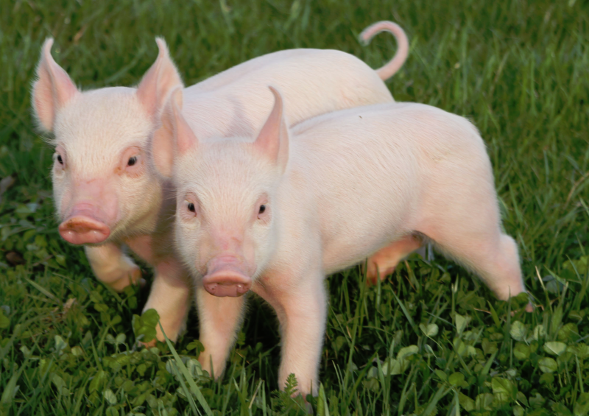
Error Detection/Correction
We want to know when there are errors in communication
Parity bits can tell us this, to a certain extent
But they have drawbacks
You need detect multiple parity bits to detect multiple errors
Correcting errors would be even better, though! Why?
It’d save lots of time
What are some ways we can correct errors?
Send data multiple times; take most frequently occurring bit for a given place
Send longer symbols (e.g., 11111 instead of 1)
Send data with a payload that’s a function of the payload
Like parity bits, but we need something smarter

Slide 4
Hamming Codes
Originally created by Bell Labs engineer Richard Hamming to save time on punchcard reading errors
Hamming codes now used for network communications as well as hard drive RAIDs
All other bits are message bits
00100101100
Bits in 1, 2, 4, 8, etc. positions are parity bits

Slide 5
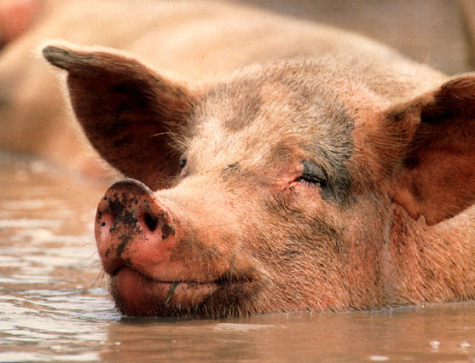
Hamming Codes
An extension of bit parity, where parity check bits are in “powers of two” positions
Bit string: 0 0 1 0 0 1 0 1 1 0 1 Bit number: 1 2 3 4 5 6 7 8 9 10 11 Par/msg: p p m p m m m p m m m
Each data bit is checked (with even parity) by check bits that make up its “power of two” sum
Let’s look at how data bit 7 is checked
What’s 7 in binary?
00111
Which bits are 1? What powers of 2 does each correspond to?
4, 2 and 1
This means the message bit in bit 7 is added to the sums for parity bits 1, 2 and 4

Slide 6
Hamming Codes
All parity bits are calculated like this: binary addition of the message bits they check, with no carry
Possible to detect single-bit and double-bit errors
Possible to recover from single-bit errors
See Hamming lecture (will be linked on calendar) for more details

Slide 7
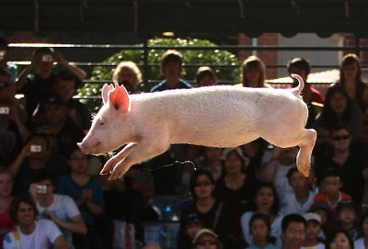
Hamming Distance
Hamming distance: minimum number of bit flips necessary to change one string into another
Examples:
What’s the Hamming distance between:
10001 and 10000
00111 and 00000
10100 and 01011
Hamming distance can also describe a general way of coding data
Imagine system where possible “symbols” are 1111, 0000, 0011, and 1100
In this system, what’s the Hamming distance?
2
What about system consisting of codes 00000 and 11111?
5
In this way, Hamming distance describes robustness to noise

Slide 8
Frequency & Bandwidth
Frequency: rate of an oscillation
Bandwidth: measures the width of a range of frequencies
Bandwidth = freq_{upper} - freq_{lower}
Human hearing bandwidth: ~20kHz (20kHz - 20 Hz)
“Bandwidth” and “bitrate” are often used interchangeably; this is a different definition
Bonus Question: what’s the frequency range and bandwidth of 802.11 b/g?
2.4 GHz to 2.5 GHz; 100 MHz

Slide 9
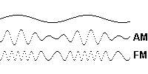
Shannon’s Theorem
Also called “noisy-channel coding theorem”
Tells about maximum bitrate in the presence of noise
Max. bitrate = bandwidth * log₂(1 + signal/noise)
C = B log₂(1 + S/N)
Intuitive understanding
Sending signal over a wave with amplitude modulation
As the wave changes, each amplitude can correspond to a different symbol
Less noise means we can detect symbols more precisely!
What are the implications of this?
More power -> higher data rate
More bandwidth -> higher data rate
This is why companies fight so much (pay so much) for spectra!

Slide 10
Nyquist Rate
To recover a waveform, the sampling rate must be at least two times the highest frequency
Telephone sampling rate is 8kHz; what are the implications of this?
What sampling rate would be required to recover all frequencies audible by humans? (Up to 20kHz)
40KHz
Audio CDs use 44.1kHz sampling rates for this reason

Slide 11
Code Division Multiplexing (1)
All stations send at the same time, with same frequencies
Each station has a unique chip sequence, all orthogonal to each other
E.g., (1,1,1,1) ⊥ (1,1,-1,-1) ⊥ (1,-1,1,-1)
Each of these is a symbol: a station sends its sequence for 1, and the negation of that sequence for 0
Receiver decodes signal by taking the dot product of the received signal with the chip sequence for each station

Slide 12
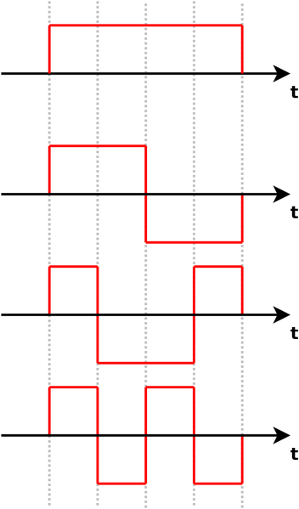
Code Division Multiplexing (2)
Signals on the right are all orthogonal (including each one’s negation)
If added on top of each other, they’re always separable with the method on the previous slide
Quick example on the board

Slide 13
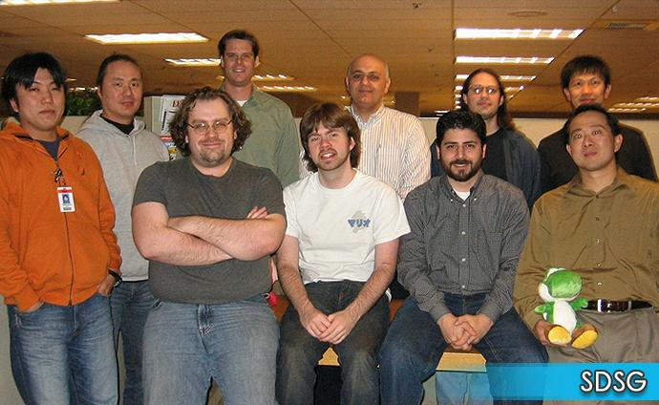
Network Programming in Action: Nat Stories
Worked at Nintendo from 2005 to 2007, then from 2010 to 2013
Helped game developers with programming issues, hardware and API questions, and bug troubleshooting
Basically a TA for game developers!
The first time, focused on graphics and gameplay
The second time, focused on network features

Slide 14
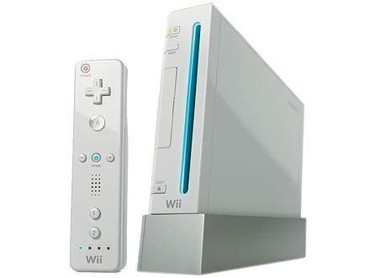
Network Programming in Action: Nat Stories
Lots of network features on Nintendo platforms (and most game platforms)
Nintendo Wii had:
802.11 Wi-Fi and Ethernet via USB
Online multiplayer and matchmaking framework (Nintendo Wi-Fi Connection)
Online rankings
User-specific data storage servers
User-to-user and Nintendo-to-user messaging system (WiiConnect24)
Ad-hoc communication with Nintendo DS
Uploading game executables to a DS for “Download Play”
Marketplace: Wii Shop Channel
Parental Control system and user relationships via “Friend Codes”
Other consoles, like Nintendo 3DS, had many more network-related features

Slide 15
Network Programming in Action: Nat Stories
Helped developers optimize protocols for sending/receiving gameplay data
Wrote FAQs and whitepapers about network communication
Helped developers figure out if their implementations met all of the official Nintendo guideline
Helped design and improve proposed network features for new consoles
Answered lots of e-mails like this:
Hi :
1. use wii develop machine connect to a router .
2. cutoff router power
3. Open router power,
4. Wii try to connect router
5. Always fail. And error code 51031.
How to solve it ?

Slide 16
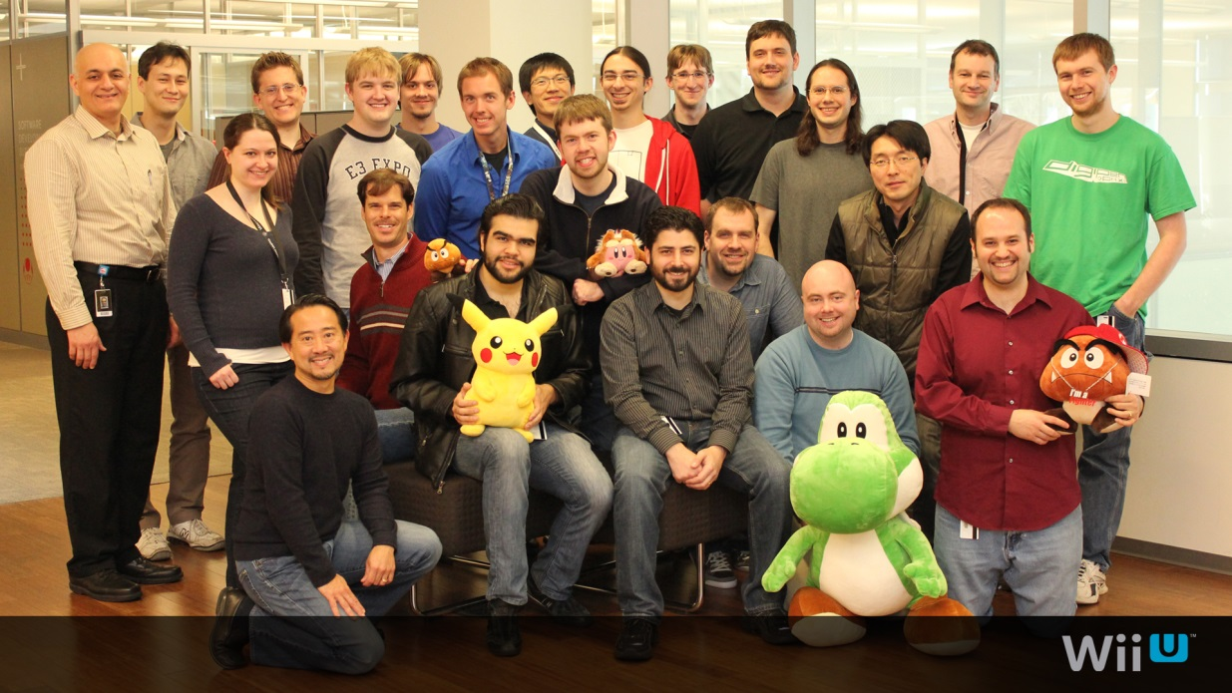
Network Programming in Action: Nat Stories
Networking is used lots in video games
Performance-heavy area where new application-level protocols are designed all the time
Really awesome industry to get into if you want to work with networking, graphics, or design tools
Let me know if you want industry contacts!

Slide 17
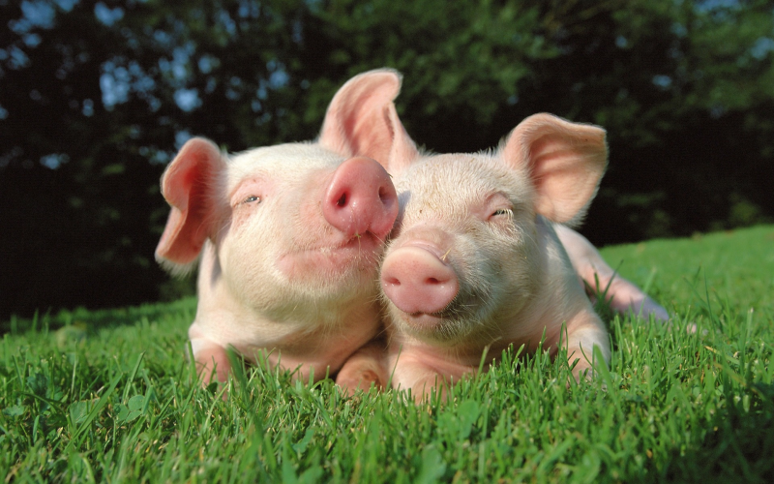
Reminder
Make sure you fill out course evaluations!!

